Slide 1
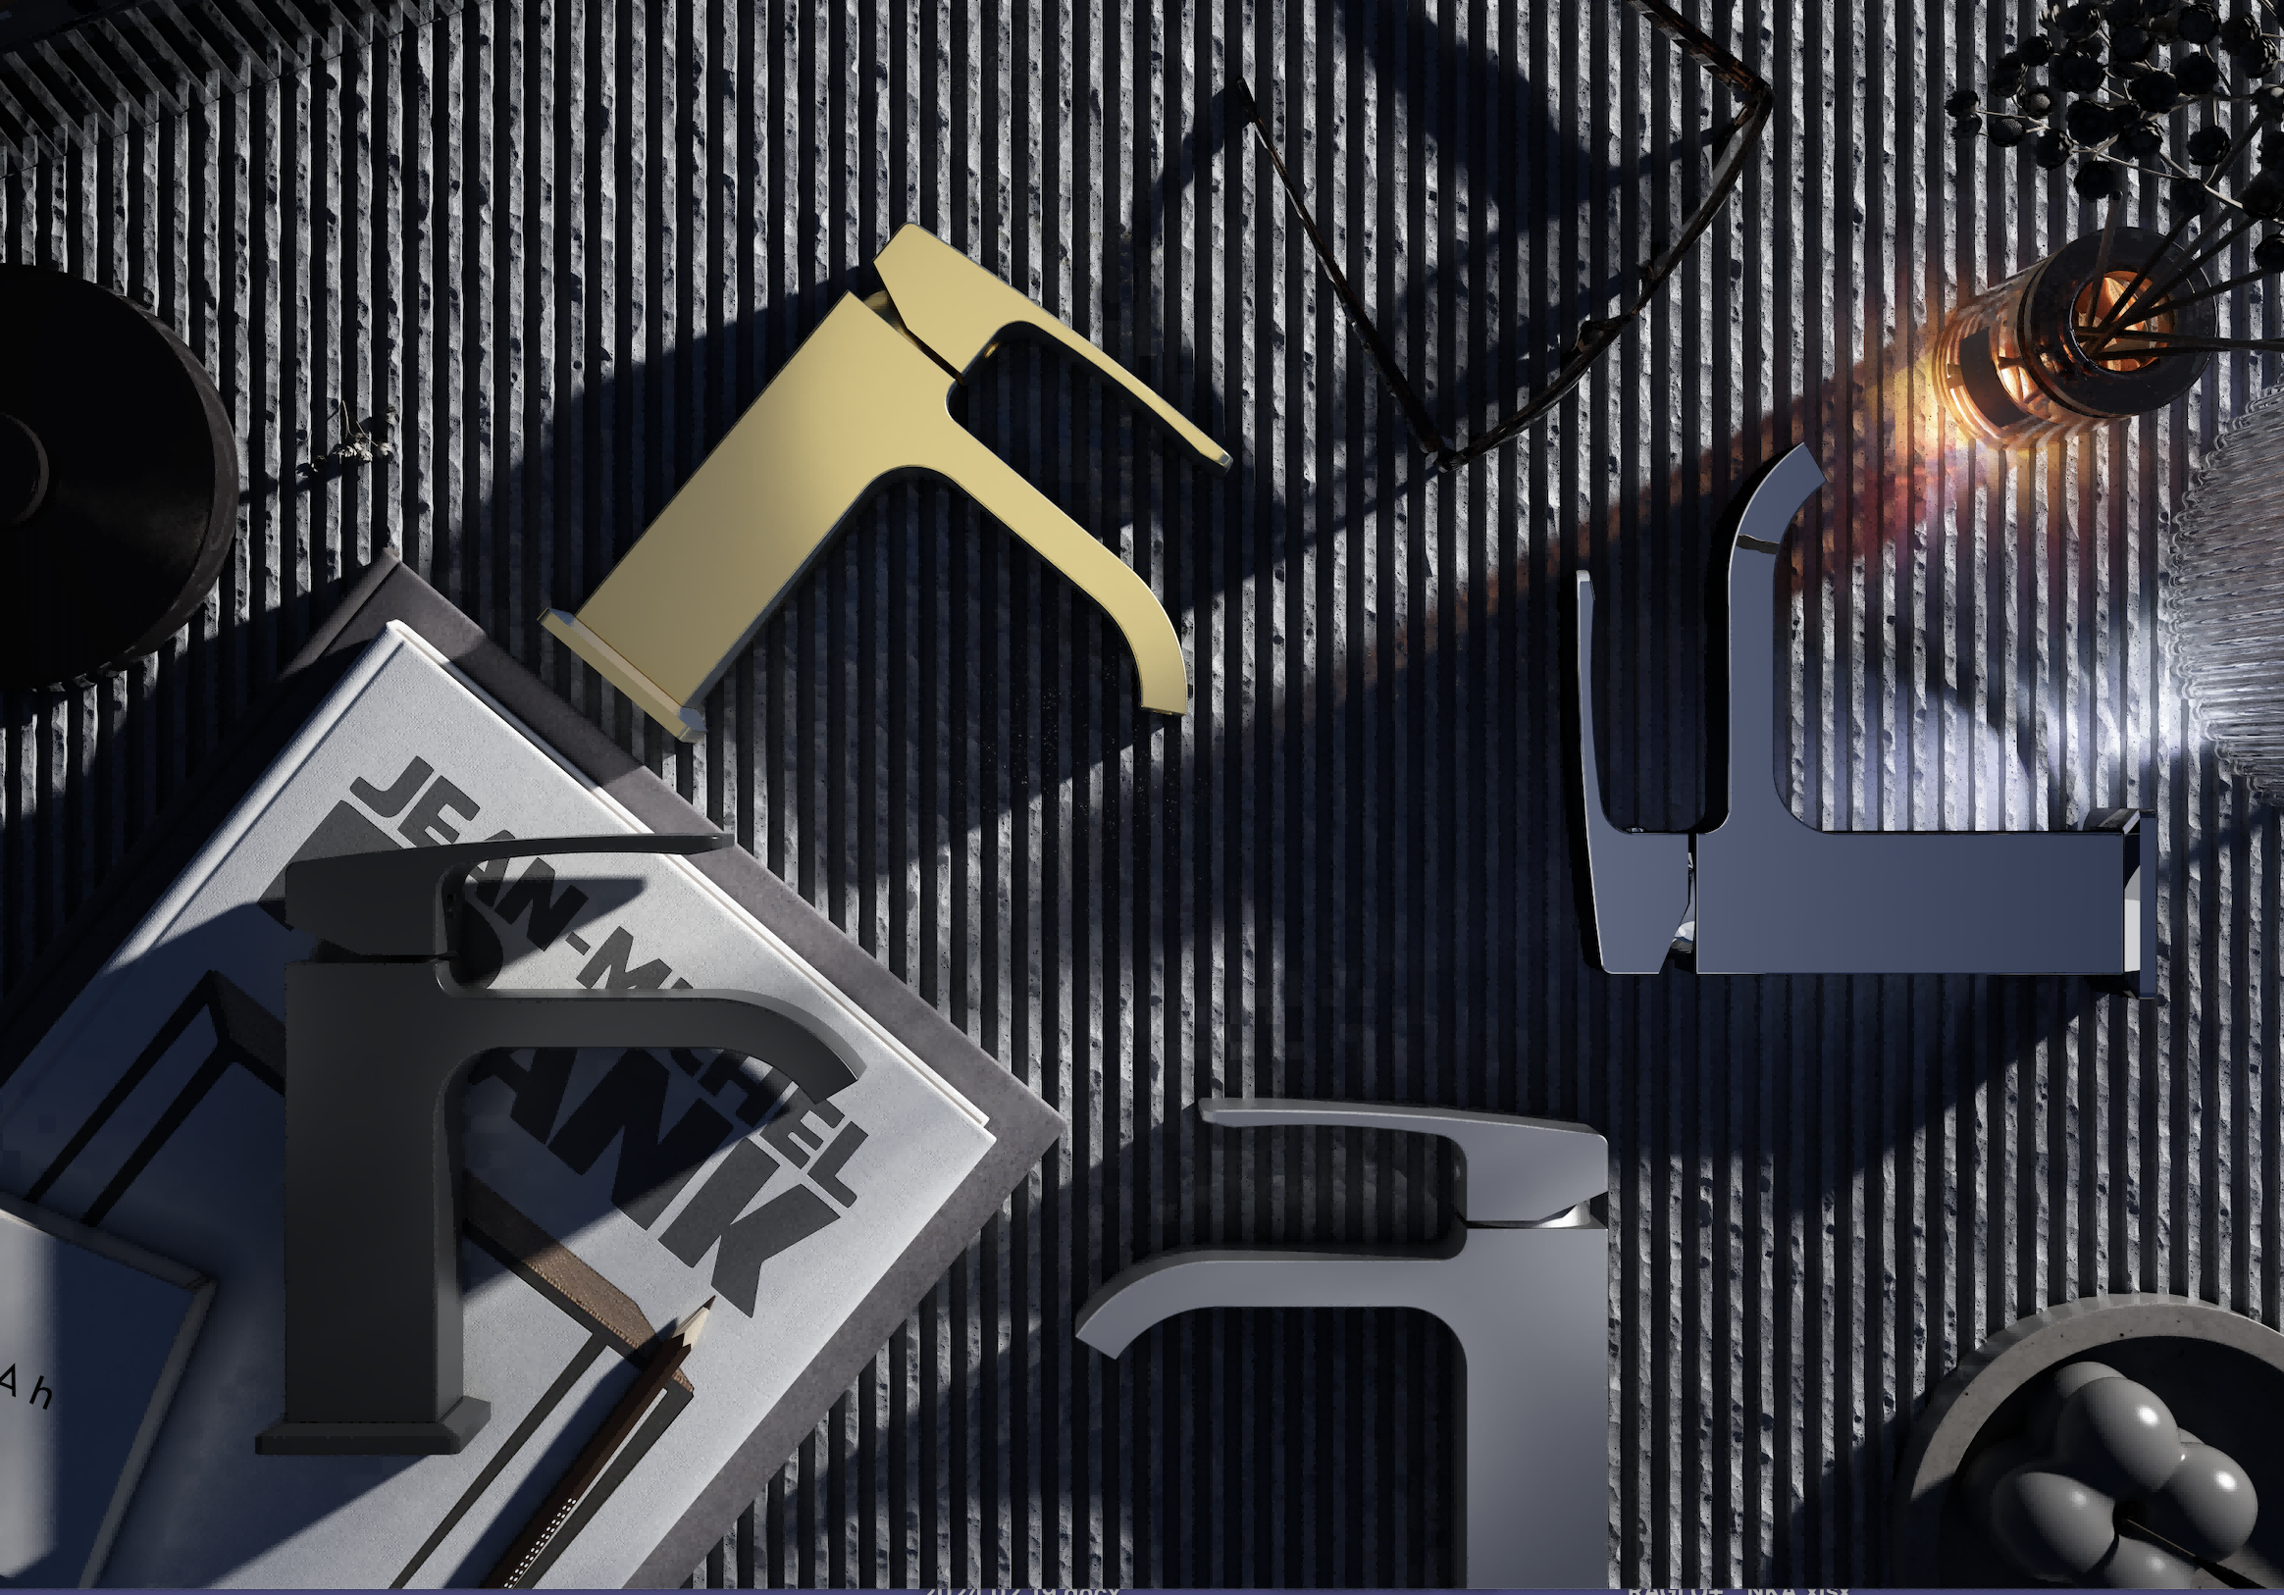


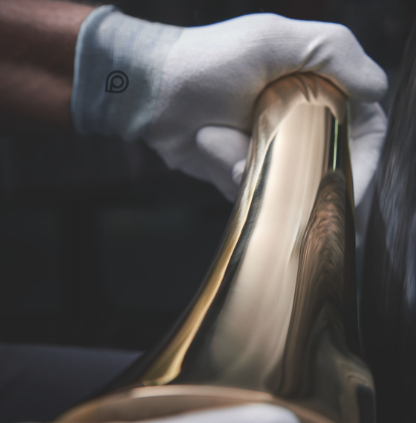
MAXISHOP Europe

Slide 2


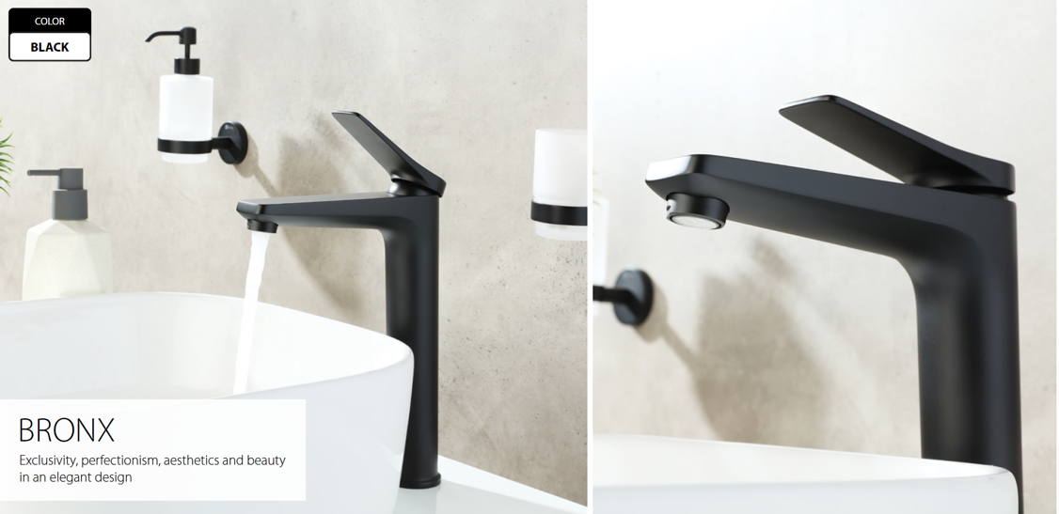
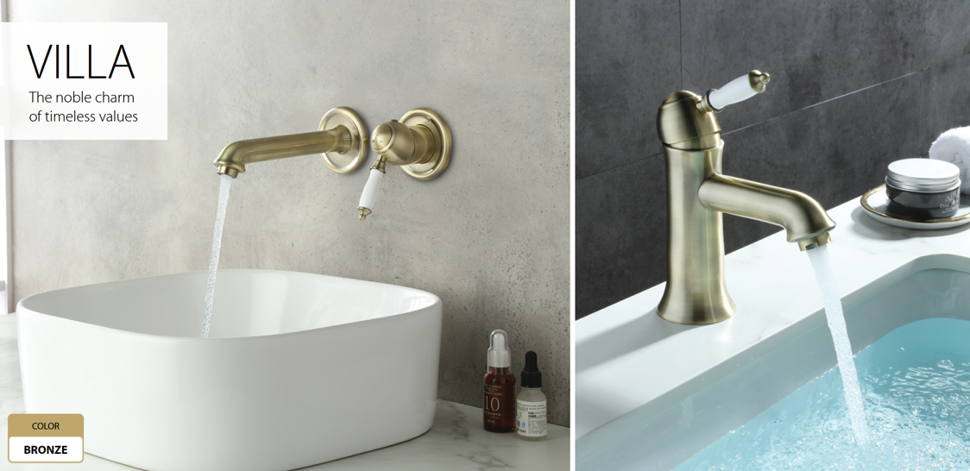
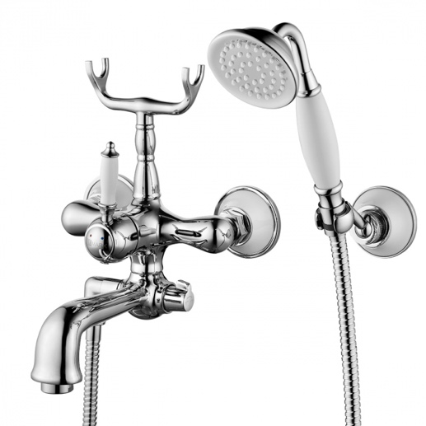
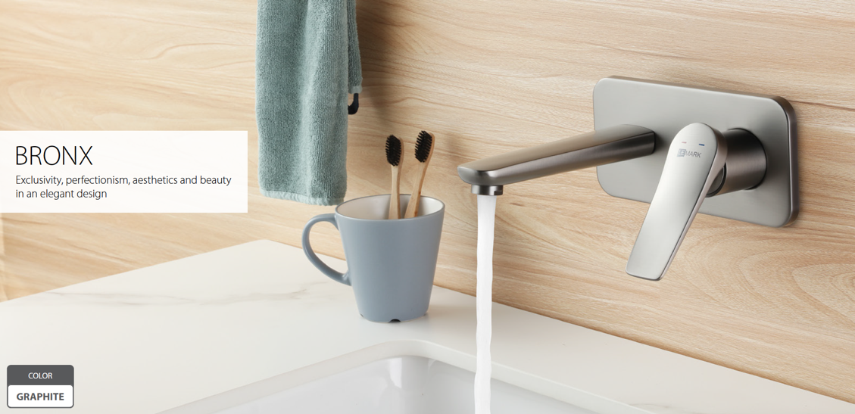
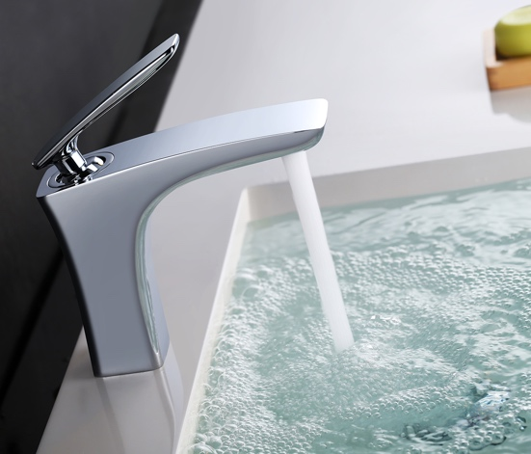
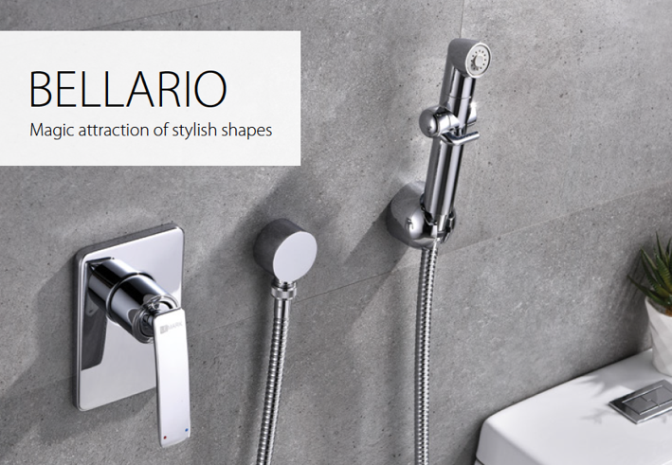
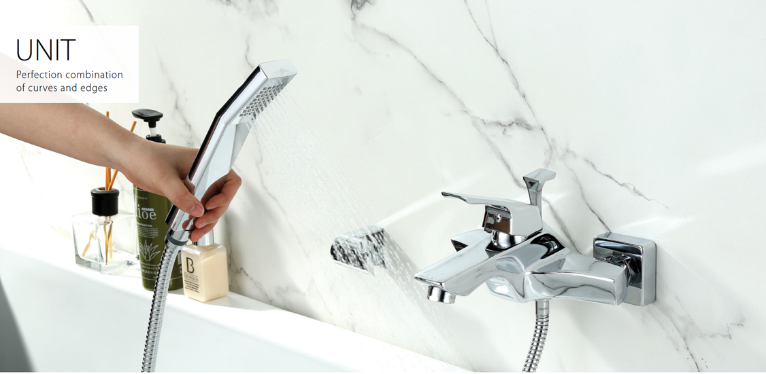
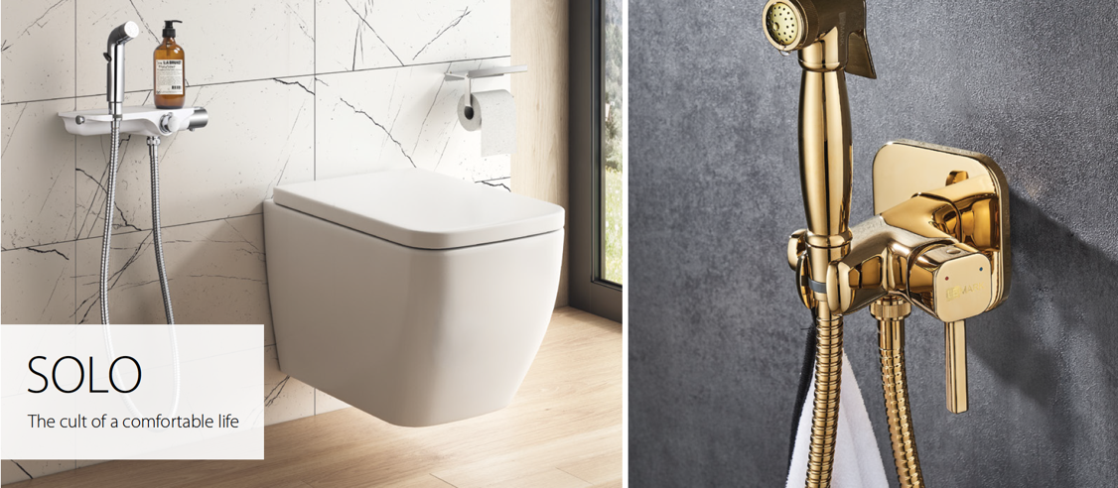
Collections in stock
Crom

Slide 3
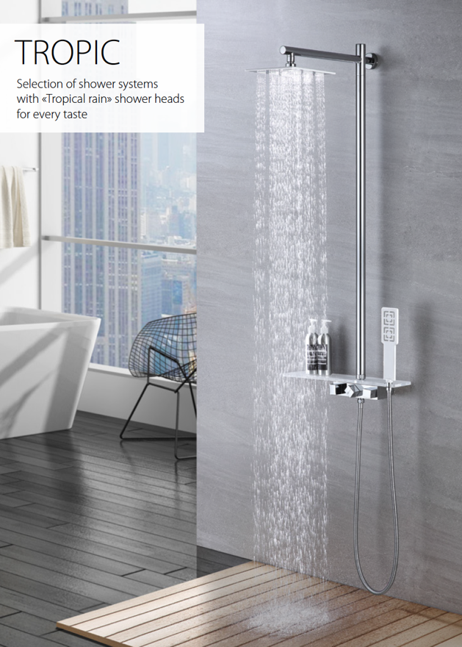
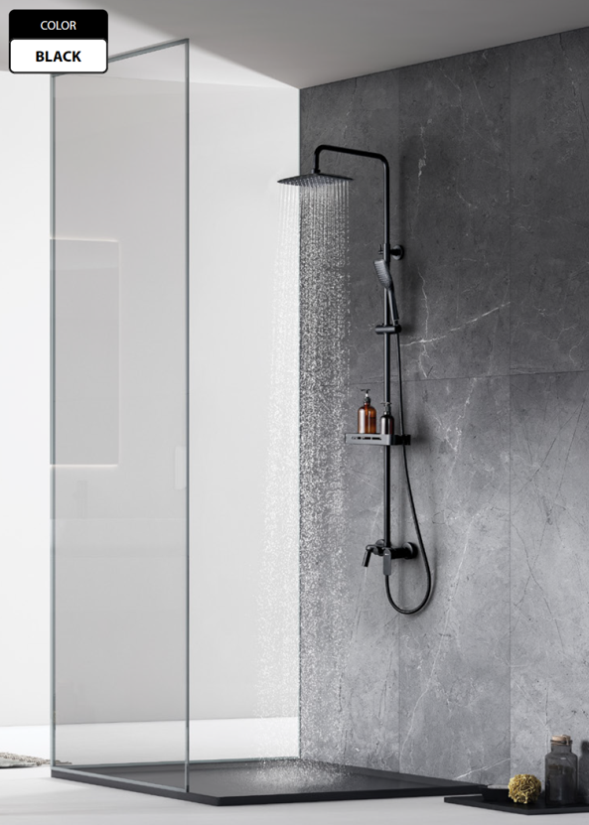
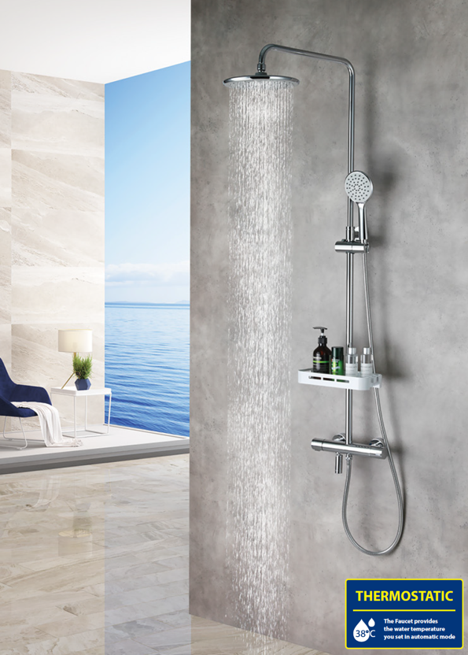
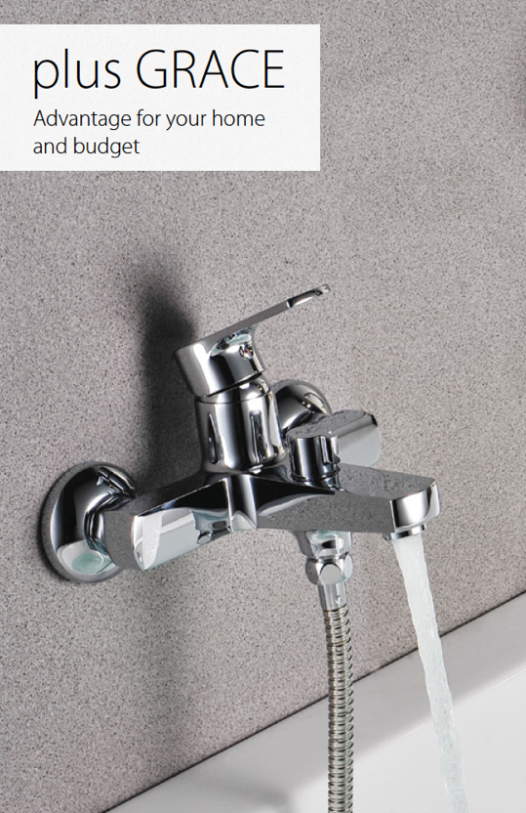
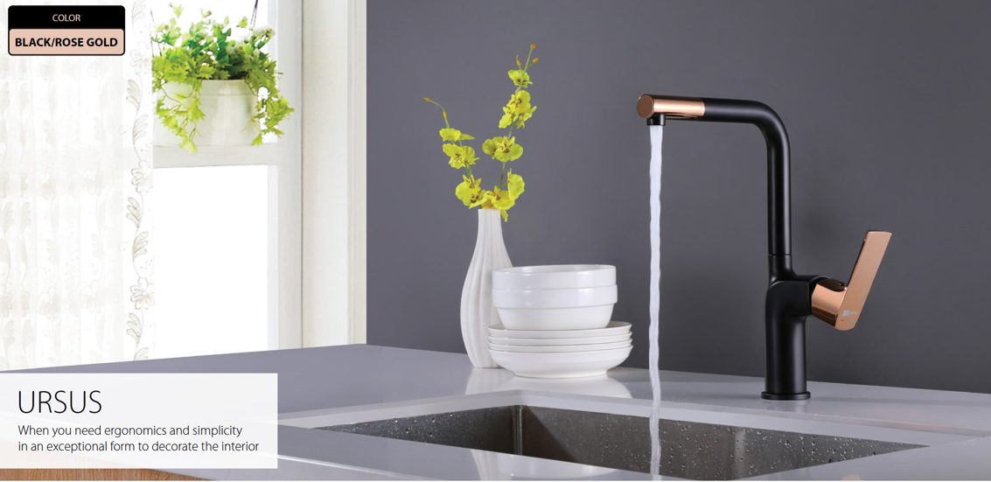
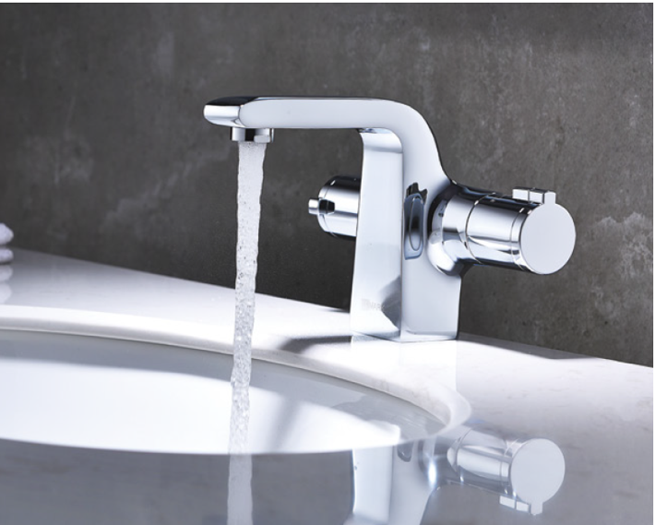
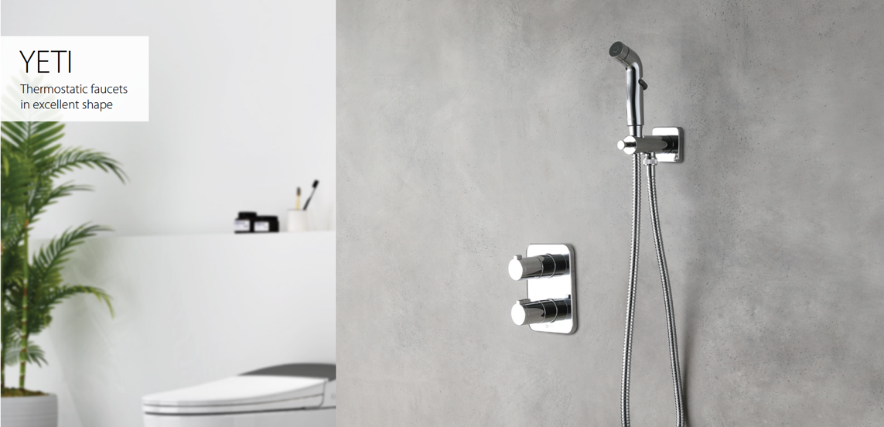
Collections in stock

Slide 4
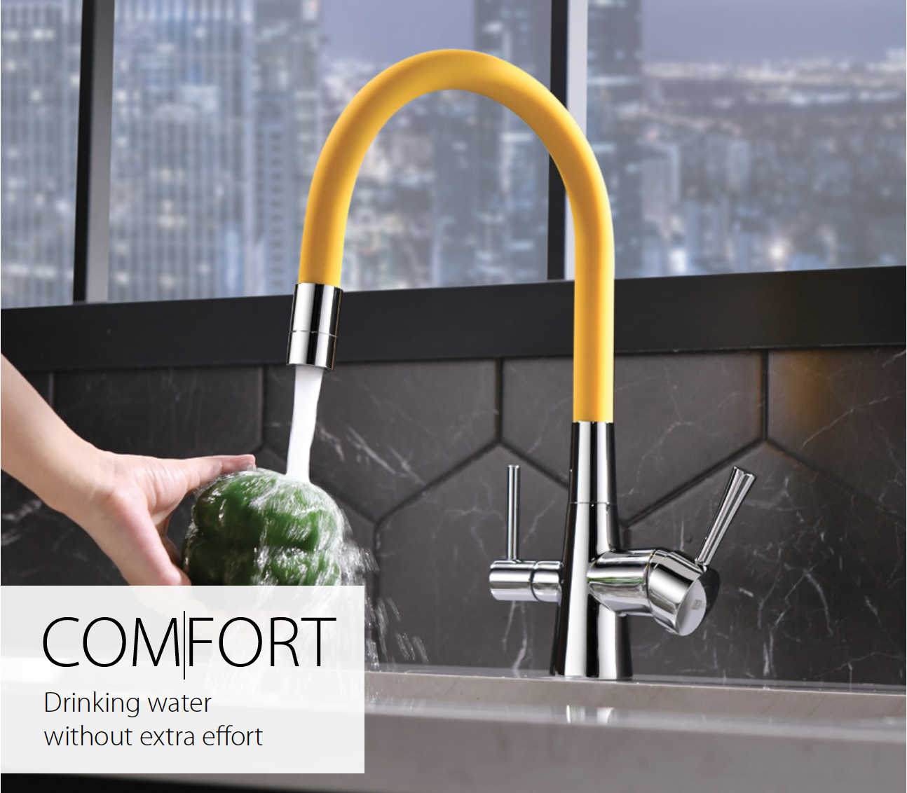
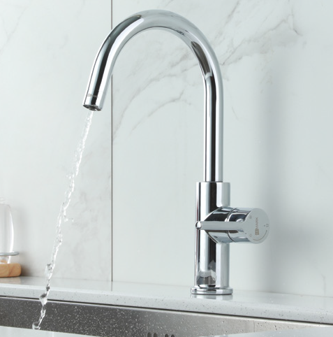
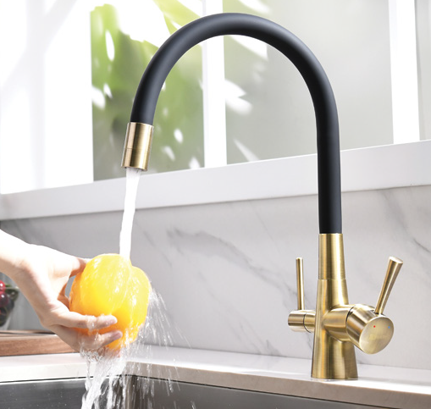
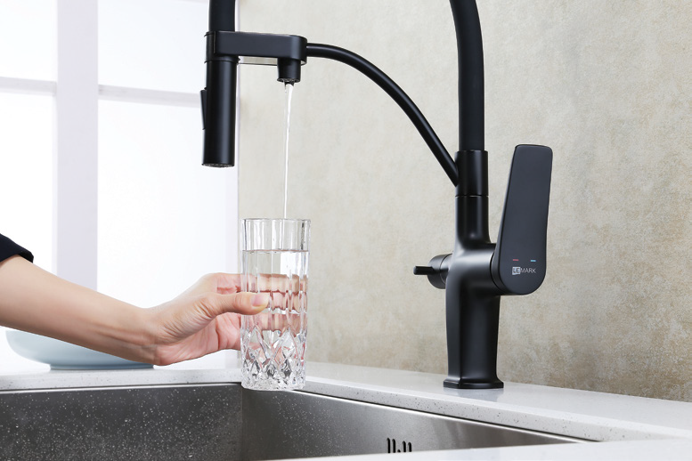
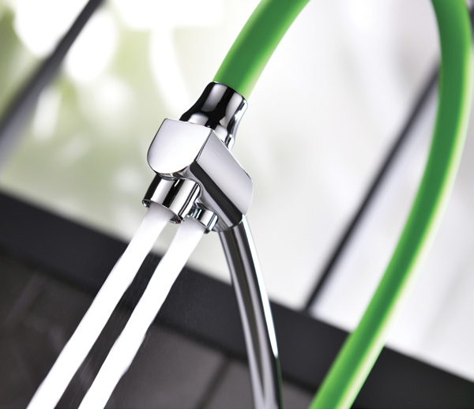
Collections in stock

Slide 5
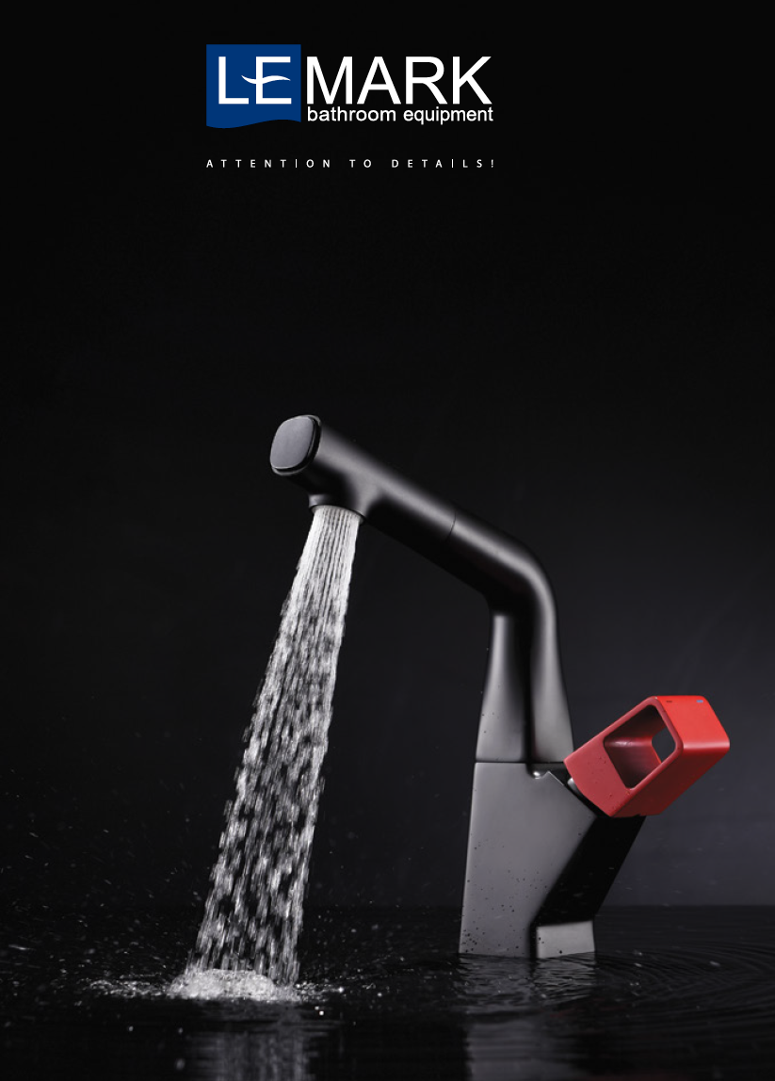
Offer
HIGH QUALITY AT A FAIR PRICE
The wide range of LEMARK sanitary faucets includes over 50 different collections – from classic to designer, for all installation locations, for every taste and budget.
Reliable and easy-to-use LEMARK faucets will ensure you a comfortable life.
All LEMARK faucets are manufactured according to two basic principles: attention to detail and superior quality at a reasonable price.
All sanitary faucets are manufactured in accordance with international regulations and European standards. The quality control system of the company's production and technological management processes is certified according to the ISO 9001 system.
LEMARK uses high-quality components from the world's leading manufacturers of parts specially created for your products.
LEMARK products undergo strict checks at every stage of the production cycle to provide the best guarantees regarding product quality. LEMARK OFFERS CUSTOMERS 10 YEARS OF FREE SERVICE!

Slide 6


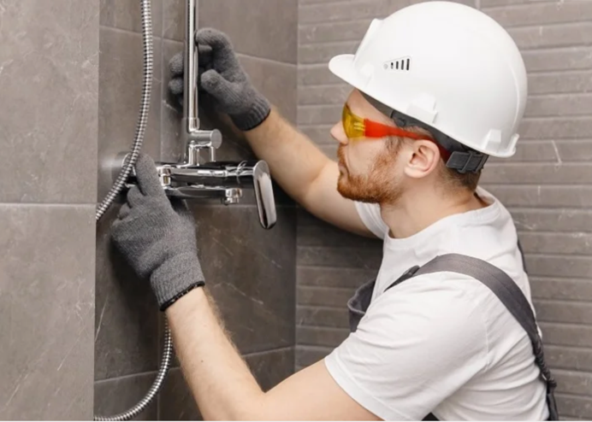
Warranty
The faucets benefit from free service for 10 years from the date of purchase. The service covers the main component parts of the faucet: cartridge, cartridge with ceramic seals, diverters - switches.
In the service, the mentioned parts can be repaired and/or replaced free of charge (based on the decision of the service center, in accordance with the detailed conditions in the warranty certificate).
The free service is only available to end users upon presentation of a fully completed warranty certificate and the fiscal receipt. Faucets installed in public spaces are not eligible for free service.

Slide 7










Production
MANUFACTURING PROCESS AND TECHNICAL SOLUTIONS
QUALITY CONTROL INCLUDES
ALL MANUFACTURING STAGES
HIGH-QUALITY MATERIALS
RAW MATERIAL QUALITY CONTROL
- USING X-RAY SPECTROMETRY TO VERIFY COMPOSITION
CERTIFICATION
BATTERY BODY CHECK
– VISUAL INSPECTION IS CARRIED OUT TO DETECT SURFACE DEFECTS, CRACKS, FISTULAE
QUALITY CONTROL AT ALL STAGES OF PRODUCTION
QUALITY CONTROL OF THE POLISHING AND MECHANICAL TREATMENT PROCESS
CARRIED OUT AFTER THE COMPLETION OF THE TECHNOLOGICAL PROCESS OF POLISHING AND MECHANICAL TREATMENT OF THE BATTERY BODY
HIGH-QUALITY COMPONENT FROM ESTABLISHED MANUFACTURERS
CHECK FOR DEFECTS ON THE BATTERY SURFACE
- THICKNESS OF THE CHROME-NICKEL COATING USING A SPECTROGRAPH
- RESISTANCE TO AGGRESSIVE ENVIRONMENTS AND QUALITY IS CHECKED USING STEAM FROM WATER AND SALT
TESTING OF ASSEMBLED FINISHED PRODUCTS
TESTING OF TIGHTNESS ON STANDS WITH WATER AND AIR
CONTROL OF THE TIGHTNESS OF THE FINISHED PRODUCT

Slide 8
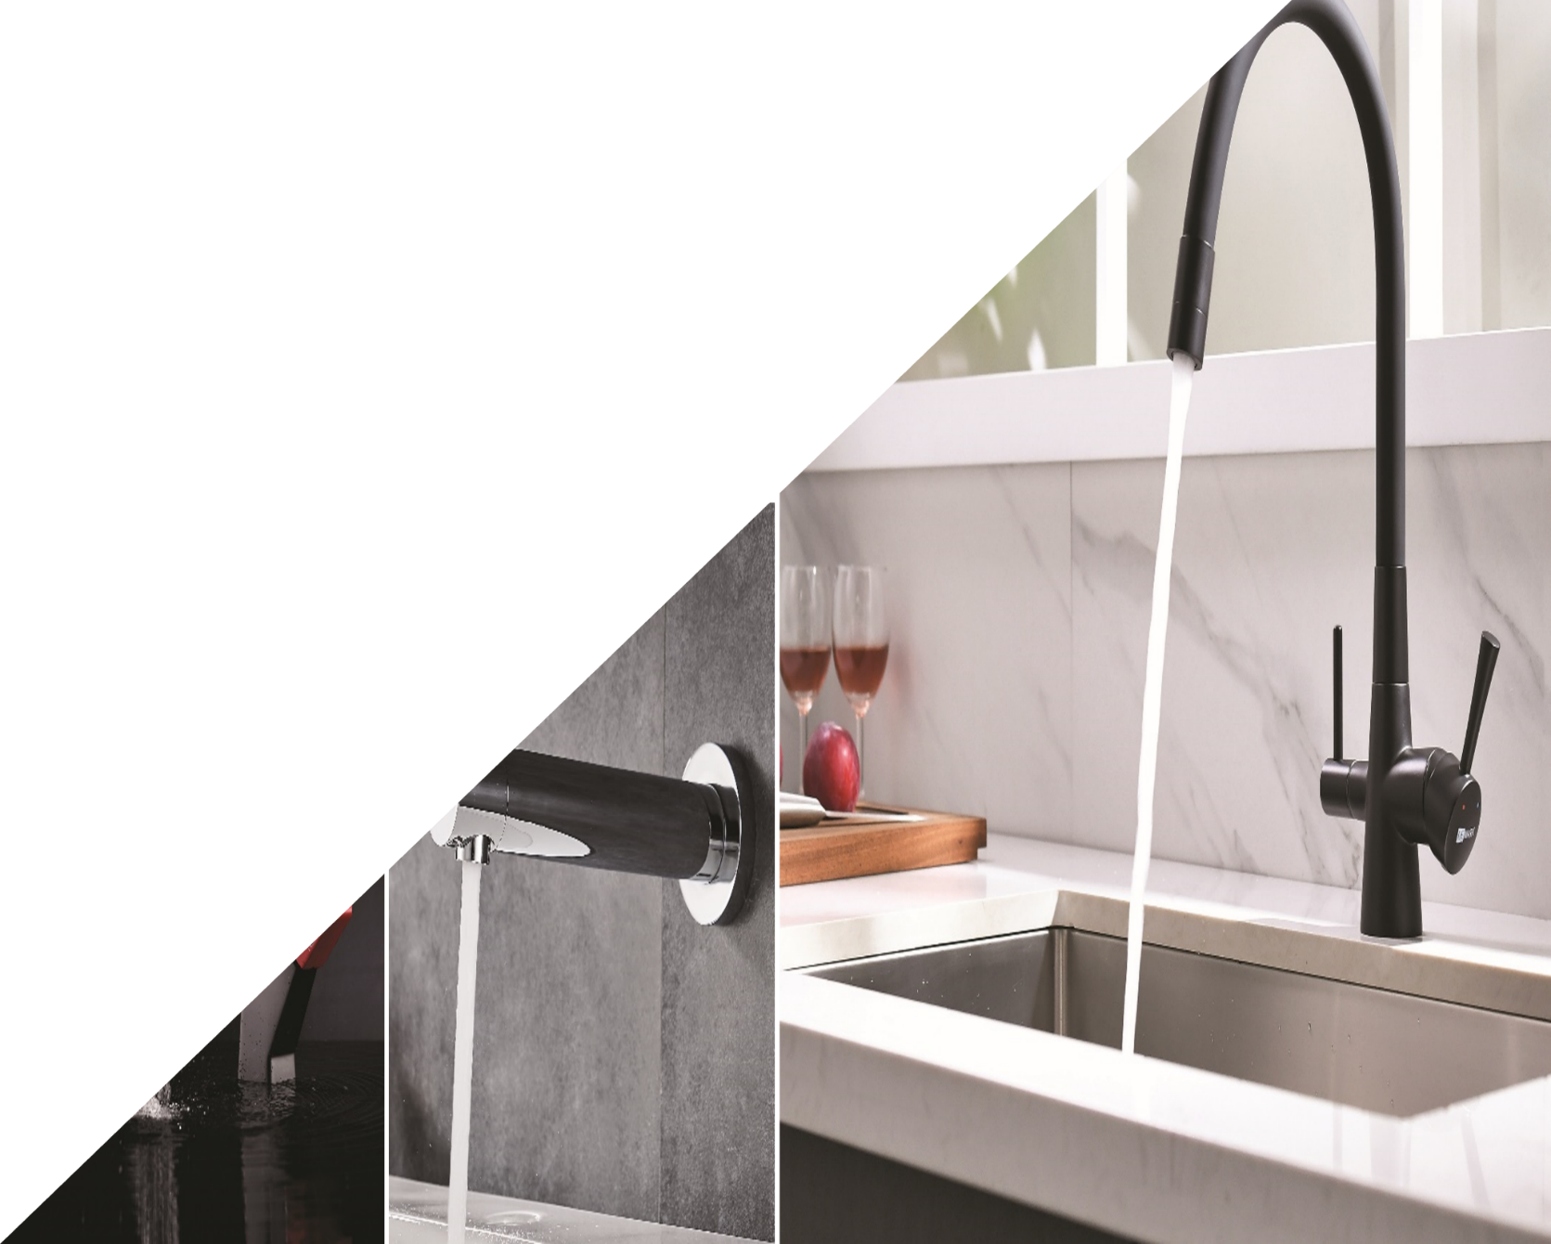
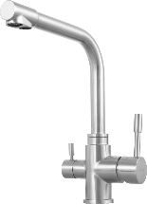

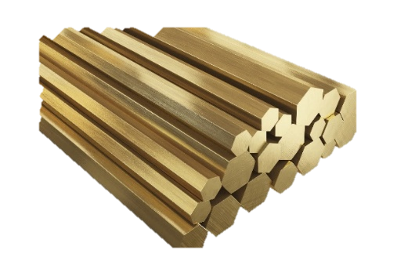
Raw Material
HIGH-QUALITY MATERIAL
STAINLESS STEEL 1.4301
In the USA, this type of steel is known under the AISI 304 brand..
BRASS WITH LOW LEAD CONTENT
Zn / zinc
36,5-39,5%
Cu / copper 59.25-60.25%
Pb / lead
1,2-1,6% *
Al / aluminum
0,55-0,75%
Sn / tin up to 0.2%
Ni / nickel
up to 0.2%

Slide 9


Coverage
COATING LAYER APPLICATION TECHNOLOGIES
CHROME
GALVANIZING
CHROME-NICKEL COATING
COLORS: CHROME, BLACK
COLOR
GALVANIZING + PAINTING
CHROME-NICKEL COATING AFTER POWDER PAINT APPLICATION
COLORS: CHROME + WHITE
COLOR
PVD
(VACUUM PLASMA SPRAYING AND ION PLATING BY DIRECT CONDENSATION OF THE APPLIED MATERIAL VAPORS)
COLORS: GOLD, ROSE GOLD, BRONZE, AGED BRONZE, GRAPHITE

Slide 10

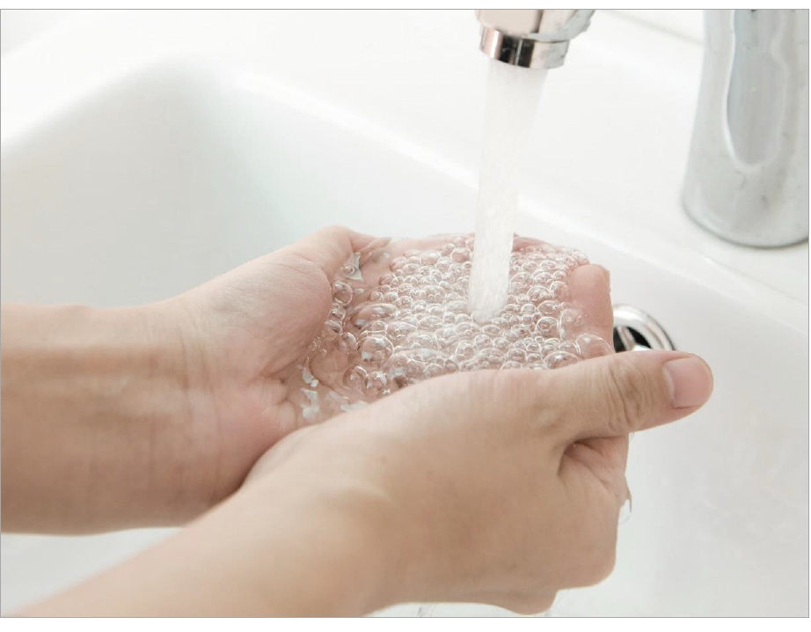
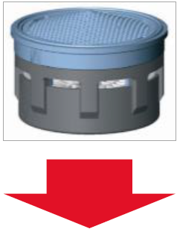
Aerators
The Neoperl and Lemark aerators allow faucets to produce a constant, uniform water flow rich in oxygen.
Aerators provide faucets with an unmatched level of comfort and smoothness and also reduce splash intensity when water hits the surface of the sink/basin.
Water passes through the aerator's grille and creates a rarefied space where air enters.
Aerators meet the requirements of the European standard EN 246 'Sanitary tapware - General specifications for flow rate regulators.'
The water jet becomes voluminous, uniform, and pleasant to the touch.

Slide 11

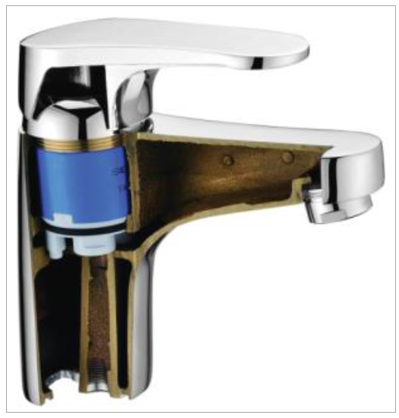
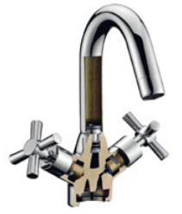
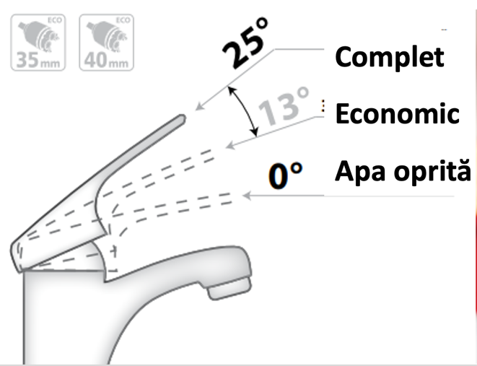

Cartridges
LEMARK faucets are equipped with cartridges featuring ceramic discs and ceramic plate cartridges of 25mm, 35mm, and 40mm from world-renowned manufacturers: Sedal, Wanhai, Hassem, Yizhan Cartridge.
The cartridges ensure precise control of the water temperature and a smooth water flow.
Thanks to the high-quality cartridges, the lifespan of the faucets is up to
Eco-cartridges are the models with a 50% water-saving function.
The cartridges comply with the European standard EN 817 "Sanitary tapware. Mechanical mixers. General technical specifications", which regulates the technical operating and performance conditions of faucets for sanitary installations.

Slide 12
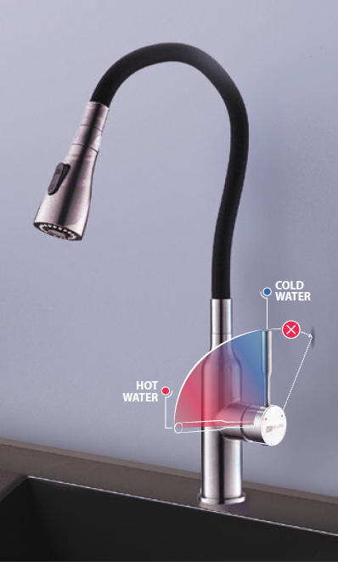
Cartridges
Other types of cartridges
Sedal® Cold Start Termaclick
Sedal® Cold Start Termaclick - it is eco-friendly and safe.
The user feels the resistance of the handle during subsequent opening up to the 38-degree mark, which allows for a comfortable water temperature and minimizes the risk of burns caused by hot water. Additionally, the presence of a stopper will prevent wasting a larger amount of hot water than necessary.
Installed in LM3760x and LM3762x
Sedal® Cold Start Termaclick Mirror
Designed for kitchen faucet cartridges that can be installed close to the wall.
This type of cartridge eliminates contact between the faucet handle and an obstacle, limiting its range in the vertical position. Now you can fully open the cold water in the kitchen at any time.
Installed in LM3074C, LM3075C, LM3705x, LM3744x, LM3761x, LM3805C, LM3850C, LM7205x, LM7261x.

Slide 13





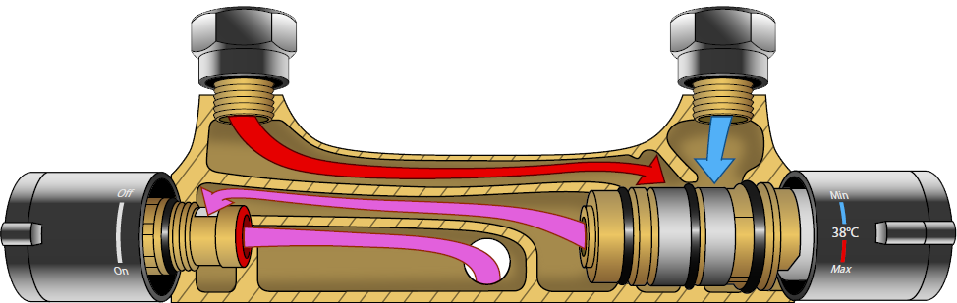
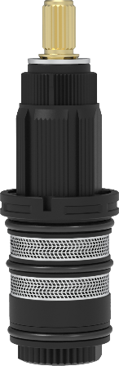
Cartridges
In the thermostatic batteries, Vernet® cartridges with gel thermocouples and flat diaphragm are used.
Cold water
Hot water
Important:
The connection to the cold water network will be made only on the right side - from the installed thermocouple.
Combined water jet
The thermoelement is equipped with a burn prevention system that responds instantly to changes in cold water pressure, significantly reducing the risk of burns from hot water.

Slide 14
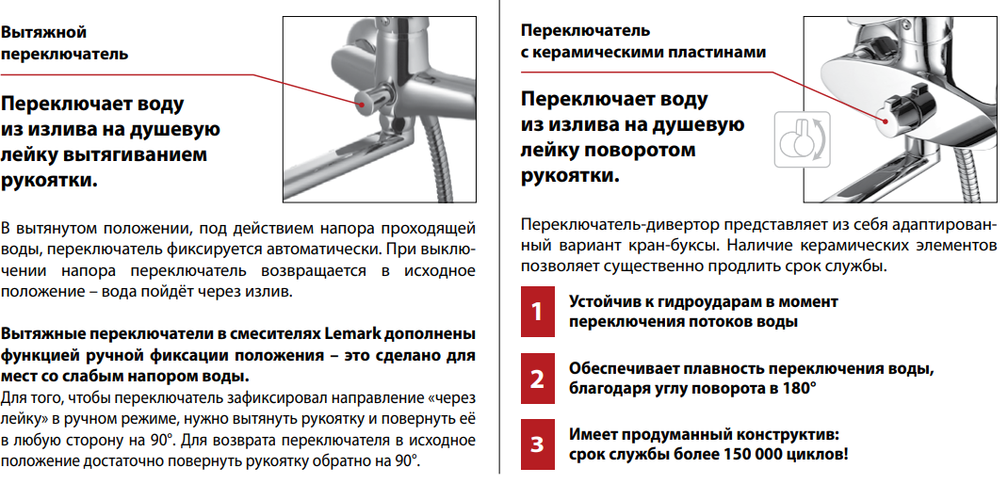
Types of switch-diverters
Comutator cu extragere
Comutator cu placi ceramice
Comută jetul de apă de la pipă spre para de duș prin extragerea mânerului.
Comută jetul de apă între pipă și para de duș prin rotirea mânerului
În poziția de evacuare, sub acțiunea jetului de apă, comutatorul se fixează în mod automat. În cazul în care jetul de apă este oprit, comutatorul revine în poziția inițială și apa va curge prin pipă.
Comutatoarele de evacuare din bateriile Lemark sunt completate cu funcția de fixare în mod manual a poziției – acestea sunt destinate pentru locațiile cu o presiune scăzută a apei.
Pentru ca comutatorul să fixeze direcția “prin para de duș” în mod manual, este necesar să extrageți mânerul și să îl rotiți în orice direcție cu 90 de grade.
Pentru a readuce comutatorul în poziția inițială, este suficient să rotiți mânerul înapoi cu 90 de grade.
Acest comutator este o versiune adaptată a cartușului cu plăcute ceramice. Prezența elementelor ceramice permite prelungirea semnificativă a duratei de viață a comutatorului.
Rezistent la șocuri hidraulice în momentul comutării jetului de apă
Asigură comutarea lină a apei, datorită unghiului de rotație de 180 de grade
Are elementele constructive bine gândite: durata de viață de peste 150.000 de cicluri!

Slide 15
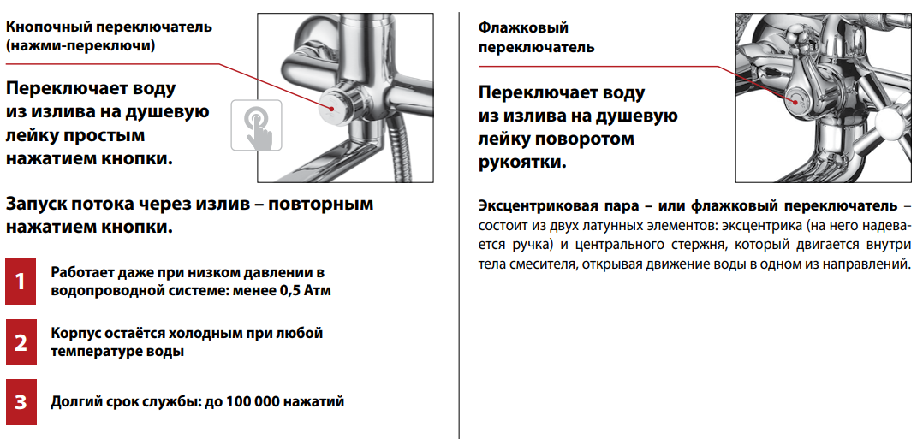
Types of switch-diverters
Comutator cu buton (apasă-comută)
Comutator rotativ
Comută jetul de apă de la pipă spre para de duș printr-o simplă apăsare a butonului.
Comută jetul de apă între pipă și para de duș prin rotirea parghiei.
Pornirea jetului de apă prin pipă - se apasă din nou butonul.
Comutatorul excentric sau un comutatorul rotativ este compus din două elemente de alamă: un adaptor excentric (pe care se fixează un mâner) și o tijă centrală, care se deplasează în interiorul corpului bateriei, deschizând mișcarea apei într-una din direcții.

Slide 16

Contacts
MAXISHOP Europe SRL
Official importer and distributor of
Address: Malešická 2855/2b, Žižkov, 130 00 Praha 3, Czech Republic
Warehouse: Popesti Leordeni, Sos. Oltenitei 202
Mobile:​ +40 733 521 582 Alex
E-mail: vanzari@sanitare-online.ro
Web: www.sanitare-online.ro

